Slide 1

Who Reviews the AI?
Code Review with Codex
Akmal Khan
Senior Full Stack AI Architect
akmalkhaniub.github.io
Notes:
Codex can build a feature for you in minutes. And that's great.
But it raises a question: who reviews the AI?
Hi, I'm Akmal Khan, a Senior Full Stack AI Architect.
And in this video, I'll show you one simple habit for shipping Codex code with confidence.

Slide 2
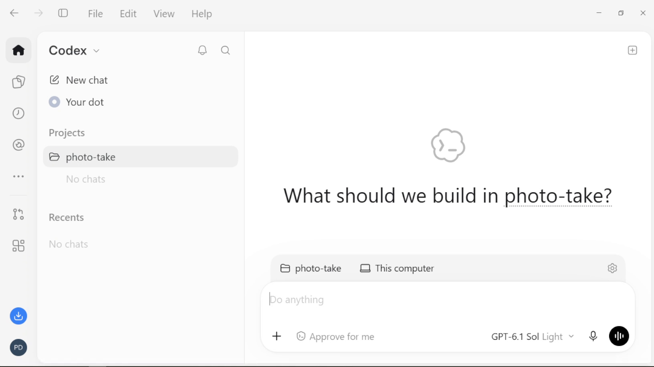
Meet Codex: OpenAI’s coding agent
📂
Reads your repo
📝
Writes the change
🧪
Runs your tests
🔍
You review the diff
Give it a task in plain English. It works in your repo like a teammate.
Codex app · CLI · IDE extension. Today: the Codex app on Windows.
Notes:
So, let's meet Codex, OpenAI's coding agent.
You describe a task in plain English, and it works just like a teammate.
[CLICK]
It reads your repository.
[CLICK]
It writes the change.
[CLICK]
It runs your tests.
[CLICK]
And then it hands the result back to you, to review.
[CLICK]
Now, today we'll use the Codex app on Windows.

Slide 3
Codex writes the code in minutes.
Now reviewing is the slow part.
📝 Writing
5 min
🔎 Reviewing
30 min
WHAT'S IN IT FOR YOU
Let Codex do the first review, so you only check what matters.
1 Feature Dev
2 Senior Reviewer
3 The proof
Notes:
But here's the catch. [CLICK]
Writing code with Codex takes about five minutes. [CLICK]
But reviewing that code? Still about thirty. [CLICK]
So the slow part isn't writing anymore. [CLICK]
It's review. [CLICK]
So what's in it for you?
By the end of this video, Codex will do the first review for you.
And you'll only spend your time on the risks that really matter. [CLICK]
We'll get there in three steps: the Feature Developer, the Senior Reviewer, and the proof.

Slide 4
The PR Looks Green. Would You Approve It?
app/profile.py
💬 The task
Let users upload a profile photo.
def upload_avatar(user_id, file):
destination = AVATAR_DIR / f"{uuid4().hex}.png"
with open(destination, "wb") as target:
✅ All tests passed
copyfileobj(file, target)
return f"/avatars/{destination.name}"
✅ Even handles errors
🤔 Would you approve this PR?
Hold that thought.
Tests check what we asked for. Not what we forgot to ask.
Notes:
Okay, let's make this real. [CLICK]
Imagine it's Friday afternoon.
You need a profile photo upload for a small bookshop app. [CLICK]
Codex writes the code. [CLICK]
All the tests pass. [CLICK]
And it even handles errors. [CLICK]
So, would you approve this pull request? [CLICK]
Take a second. Honestly, most of us would. [CLICK]
But hold that thought. [CLICK]
Because tests only check what someone remembered to test.
Not the ones we forgot.

Slide 5
What Happens If We Ship It?
Friday, 5 pm
✅
Tests are green.
PR approved.
Saturday, 2 am
⚠️
A rare failure
hits the uploads.
Monday, 9 am
🔥
Broken profile photos.
Tickets pile up.
Monday, 10 am
🙋
"Who approved
this PR?"
The fix takes minutes. A bug in production costs your users, and your weekend.
Today: catch it before you click Approve.
Notes:
So, let's say we approve it.
What happens next? [CLICK]
Friday, five pm. Tests green, PR approved.
Everyone goes home happy. [CLICK]
Saturday, two am. Something rare happens during an upload.
And nobody tested for it. [CLICK]
Monday morning. Broken profile photos.
And the support tickets start piling up. [CLICK]
And then comes the question nobody wants to hear: who approved this PR?
Sound familiar? [CLICK]
Here's the thing. The fix takes minutes.
But a bug in production costs your users, and your weekend. [CLICK]
So today, I'll show you how to catch it before you click Approve.

Slide 6


Every Pull Request Needs a Second Pair of Eyes
vs
Feature Developer
Senior PR Reviewer
“Did I satisfy the ticket requirements?”
“What breaks this in production?”
Codex wears both hats. Never in the same prompt.
Notes:
And that's exactly why good teams never approve their own pull requests. [CLICK]
The Feature Developer asks: did I meet the ticket? [CLICK]
But a Senior Reviewer asks something very different: what could break this in production? [CLICK]
Now, here's the nice part. Codex can wear both hats. Just never in the same prompt.

Slide 7
Switch hats with /review
1
2
3
4
Type /review
in the composer
Add your questions
Fails halfway? Who can call it? Empty or huge?
Read the findings
On the lines, most important first
You decide
Codex changes nothing
Two ways to ask:
/review → quick general check
/review + your questions → deep check
↑ today
Notes:
So how do we switch hats?
In the Codex app, it's just one command. [CLICK]
You type slash review. [CLICK]
And here's the trick: add the senior reviewer's questions.
What if it fails halfway? Who can call this [CLICK]
Codex reads the changes, and puts its findings right on the lines. [CLICK]
And it doesn't change a thing. You decide. [CLICK]
A plain slash review is a quick general check.
Add your questions, and it becomes a deep check. [CLICK]
And that's what we'll do today.

Slide 8
Decide what to fix. Keep it small.
def upload_avatar(user_id, file):
You send:
“Fix the findings, a test for each. Keep the scope minimal. Authorization: follow-up ticket.”
with open(destination, "wb") as target:
copyfileobj(file, target)
...
💬 Codex’s finding
Bound the upload size: huge input can fill the disk.
Codex: small fixes + tests.
Nothing else touched.
Build
Review
Commit
Never jump straight from Build to Commit.
Notes:
Now, when the findings come in, you decide what to fix. [CLICK]
Here's the code Codex wrote. [CLICK]
And here's the risky line: it copies the whole file, with no size limit. [CLICK]
Codex flags it, right on that line: bound the upload size. A huge file could fill the disk. [CLICK]
Then you send one short message: fix the findings, with a test for each, and keep the scope minimal.
Anything bigger, like authorization, becomes a follow-up ticket. [CLICK]
That way, you get small fixes, and nothing else changes. [CLICK]
So that's the habit: build, review, commit.

Slide 9
First the Feature Dev, then the Senior Reviewer.
Same Codex, same app.
1
Ask Codex to add profile photo upload (Feature Dev)
2
/review + the reviewer’s questions (Senior Reviewer)
3
Decide what to fix now, and what to defer
4
Small fix, then review again
Notes:
Alright, here's our plan for the demo. [CLICK]
First, Codex builds the photo upload as the Feature Developer. [CLICK]
Then we switch hats: slash review, plus the reviewer's questions. [CLICK]
We decide what to fix now, and what to defer. [CLICK]
And finally, a small fix, and one more review.
So let's open the Codex app.

Slide 10
One review. Real risks caught.
Feature Dev only
Feature Dev + Senior Reviewer
✓ Photo upload works
✓ Photo upload works
✓ 3 tests pass
✓ 8 tests pass: new tests for each fix
✗ 3 hidden risks the tests missed
✓ 2 risks fixed, 1 ticketed (authorization)
The tests were green both times. The review made the difference.
Notes:
Okay, let's put the two versions side by side. [CLICK]
With only the Feature Developer, the upload worked, [CLICK]
and all three tests passed. [CLICK]
But three real risks were hiding in there. [CLICK]
With the Senior Reviewer as well, it's the same feature, now with eight tests, [CLICK]
and two risks fixed, with authorization on a ticket.
See? The tests were green both times.
But the review made the difference.

Slide 11
Your turn: one habit
/review
After every Codex task. Before every commit.
📁 What if it fails halfway?
🔑 Who is allowed to do this?
💥 What if the input is empty or huge?
Questions a senior reviewer asks. Check that the findings cover them.
Notes:
So here's the one habit I'd love you to take away. [CLICK]
Slash review. [CLICK]
After every Codex task, and before every commit. [CLICK]
And when you read the findings, ask yourself three questions. [CLICK]
What if it fails halfway? [CLICK]
Who's allowed to call this? [CLICK]
And what if the input is empty, or huge?

Slide 12
Review is the new bottleneck
Switch hats: /review + your questions
Decide what to fix. Keep it small
Codex finds. You decide
Notes:
Alright, let's wrap up. [CLICK]
Review is the new bottleneck. [CLICK]
So switch hats with slash review, and ask the senior reviewer's questions. [CLICK]
Decide what to fix, and keep the fix small. [CLICK]
And always remember: Codex finds. You decide.
I'm Akmal Khan.
Thanks for watching, and happy re viewing!

